Slide 1
AWS Services Summary
Jae Hyeon Kim

Slide 2
Services
Networking
Computing
Storage and Database
Security
Container
Serverless

Slide 3





Networking
AWS VPC
AWS Transit Gateway
AWS ELB
AWS VPC Peering
AWS Route 53

Slide 4


Computing
AWS EC2
AWS EBS

Slide 5





Storage and Database
AWS EBS
AWS RDS
AWS ElastiCashe
AWS Aurora
AWS DynamoDB
AWS S3

Slide 6



Security
AWS IAM
AWS CloudTrail
AWS CloudWatch

Slide 7
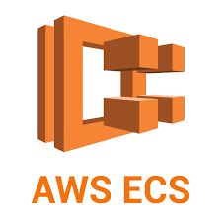

Container
AWS ECS
AWS EKS

Slide 8


Serverless
AWS Lambda
AWS Fargate

